Slide 1
Changing compound interest rates
Task A: Using powers of 10 to simplify calculations
1) Match the calculation with the calculation using exponential form.
200 × 400
8 × 10
200 × 4000
8 × 10⁵
2 × 40
8 × 10⁴
8000 × 1000
8 × 10⁶
2) Match the calculation with the calculation using exponential form.
200 × 600
12 × 10⁴
200 × 6000
1.2 × 10²
2 × 60
12 × 10⁵
3000 × 4000
1.2 × 10⁷
3) Fill in the missing numbers. Make sure to show your working out.
a) 9000 × 100 = 9 × 10⬚
5
3
4
b) 300 × 250 = 75 × 10⬚ = 7.5 × 10⬚
9 × 1000 ×
1 × 100
3 × 100
×
25 × 10
9 × 1 ×
1000 × 100
3 × 25
×
100 × 10
9 ×
10 000
75
×
1000
9 ×
10⁵
75
×
10³
7.5 × 10
×
10³
7.5
×
10 × 10³
5
6
7.5
×
10⁴
c) 4000 × 1500 = 60 × 10⬚ = 6 × 10⬚
4 × 1000
×
15 × 100
4 × 15
×
1000 × 100
60
×
100 000
60
×
10⁵
6 × 10
×
10⁵
6
×
10 × 10⁵
6
×
10⁶

Slide 2


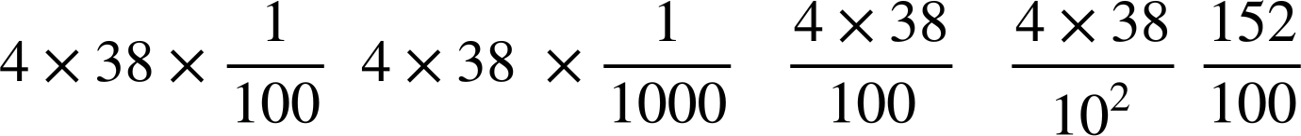

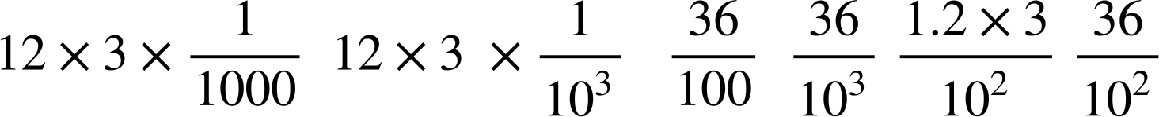
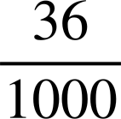
Changing compound interest rates
4) Put a tick next to the calculations which are correct and create two of your own correct calculations using powers of 10.
___________
240 × 10
E.g. 6 × 4 × 10³
There are an infinite number. Just ensure your calculation equals 24 000
24 × 10³
___________
24 000
E.g. 240 × 10²
8 × 3 × 10³
2.4 × 10⁴
12 × 2 × 10³
TASK B: Using equivalent fractions to simplify calculations
1) Identify the equivalent calculations to 3.4 × 9.3
a
b
c
d
e
2) Identify the equivalent calculations to 0.4 × 3.8
a
b
c
d
e
This required you to calculate the answer to 4 × 38 = 152
3) Put a tick next to the calculations which are correct and create two of your own correct calculations using powers of
There are an infinite number. Just ensure your calculation equates to 0.036
E.g.
________
1.2 × 0.03
E.g.
________
2

Slide 3
Changing compound interest rates
4) Create your own calculation and six equivalent calculations using powers of
________
________
________
________
________
________
There are an infinite number of answers. Ensure to check with a calculator or written methods.
Mathematics in Education and Industry
v2.3

